Slide 1
CYBERSECURITY PROJECT — FINAL SUBMISSION
Implementing Security into a
Secure Password Manager Application
VW
A self-hosted Vaultwarden deployment, hardened and independently verified in a controlled Kali Linux / Docker laboratory environment.
Mohammed Ali
18 September 2026
Notes:
Introduce yourself and the project: a self-hosted Vaultwarden password manager, deployed and hardened inside a controlled Kali Linux and Docker lab. Emphasise up front that every claim in this deck is backed by a specific test you ran, not just a configuration setting.

Slide 2
PROJECT OVERVIEW
Hardening a self-hosted password manager
This project deployed Vaultwarden — an unofficial, self-hosted Bitwarden-compatible server — inside Docker on Kali Linux, applied a defined set of security controls, and verified each one directly against the running system rather than relying on configuration alone.
At a glance
Vaultwarden 1.37.2 (Web-Vault 2026.7.0)
Kali GNU/Linux Rolling 2026.3, Docker 28.5.2
HTTPS/TLS + Argon2id + TOTP MFA
RBAC via organization + collections
AES-256-CBC/PBKDF2 encrypted, restore-tested backups
20 direct security tests performed
DEP
Deploy Vaultwarden via Docker Compose, then harden it iteratively (HTTP → HTTPS/TLS)
VER
Verify every control directly: curl, openssl, sqlite3, and docker logs — not just configuration screenshots
HON
Report honestly: distinguish verified results from documented-but-untested capabilities
Secure Password Manager Project — Vaultwarden Security Implementation
02
Notes:
Summarise the three-part approach: deploy and harden iteratively, verify every control directly against the running system, and report honestly where something wasn't tested. Point to the quick-facts card as the one-slide summary of the whole stack.

Slide 3
PROBLEM STATEMENT
Self-hosting shifts the security burden to the operator
Password managers concentrate enormous value behind one master secret. Self-hosting removes reliance on a vendor’s security team — but every layer that vendor would normally secure now has to be configured and verified by the operator.
What a vendor normally secures
The question this project asks
Transport encryption (TLS, certificates)
Key derivation and vault-level cryptography
Multi-factor authentication enforcement
Access control between users/organizations
Backup integrity and disaster recovery
Security monitoring and incident response
When Vaultwarden is deployed and then deliberately hardened across these layers...
...which controls can be shown to actually work, when tested directly...
...and which limitations honestly remain, rather than being assumed away?
Secure Password Manager Project — Vaultwarden Security Implementation
03
Notes:
Explain why self-hosting matters: you give up a vendor's security team and take on responsibility for every layer yourself. Frame the rest of the talk as answering: which of those layers actually held up under direct testing?

Slide 4
OBJECTIVES & REQUIREMENTS
Nine objectives, tested end to end
Build & configure
Verify & report
Deploy Vaultwarden with Docker / Docker Compose
Configure and verify HTTPS/TLS transport protection
Configure Argon2id and inspect vault ciphertext format
Enable and test TOTP MFA, including a failure path
Create an org/collection RBAC structure; verify with a second account
Create, encrypt, and successfully restore backups
Exercise usability features (search, password health)
Capture logs and produce honest limitations + recommendations
Secure Password Manager Project — Vaultwarden Security Implementation
04
Notes:
Walk through the nine objectives at a high level - deployment and configuration on the left, verification and honest reporting on the right. You don't need to read every bullet; just note that each one maps to a later slide.

Slide 5
TECHNOLOGY STACK
Verified directly from the running system
Kali GNU/Linux Rolling 2026.3
Docker 28.5.2
OS
DKR
kernel 7.0.12-2kali1
Docker Compose 2.40.3
Vaultwarden 1.37.2
SQLite 3.46.1
VW
DB
Web-Vault 2026.7.0
file-based, bind-mounted
Rocket built-in TLS
OpenSSL 3.6.3
TLS
ENC
self-signed certificate
AES-256-CBC, PBKDF2 200k iter
Secure Password Manager Project — Vaultwarden Security Implementation
05
Notes:
Note that every version number here was pulled directly from the running system - `docker --version`, `vaultwarden --version`, `sqlite3 --version` - not copied from documentation. This matters because it shows the environment is real and reproducible.

Slide 6
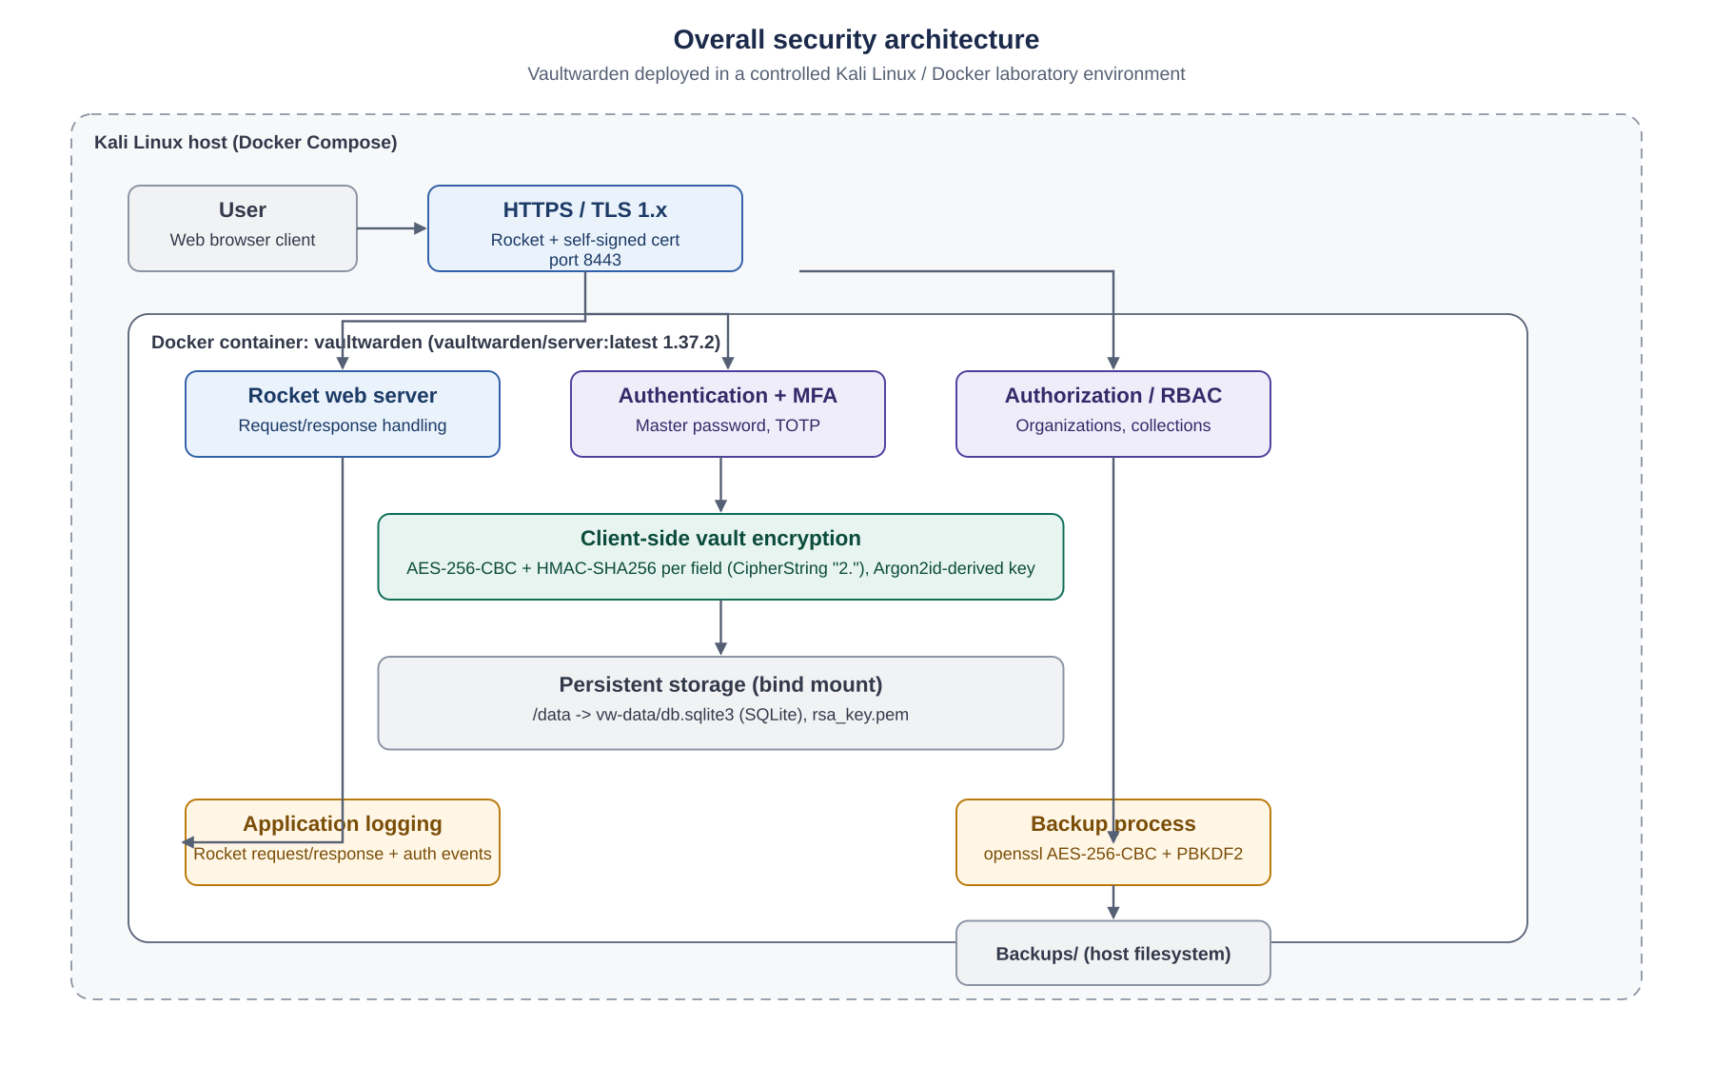
SECURITY ARCHITECTURE
One container, TLS-terminated, with layered controls
Key facts
Single Docker container: vaultwarden/server:latest 1.37.2
Rocket terminates TLS directly — no reverse proxy
vw-data bind-mounted read-write; TLS cert mounted read-only
Server never sees plaintext vault data or the master password
Secure Password Manager Project — Vaultwarden Security Implementation
06
Notes:
Walk through the architecture diagram left to right: user, TLS, then inside the container - Rocket, auth/RBAC, the client-side encryption layer, and persistent storage. Stress the key point in the right-hand card: the server never sees plaintext vault data.

Slide 7
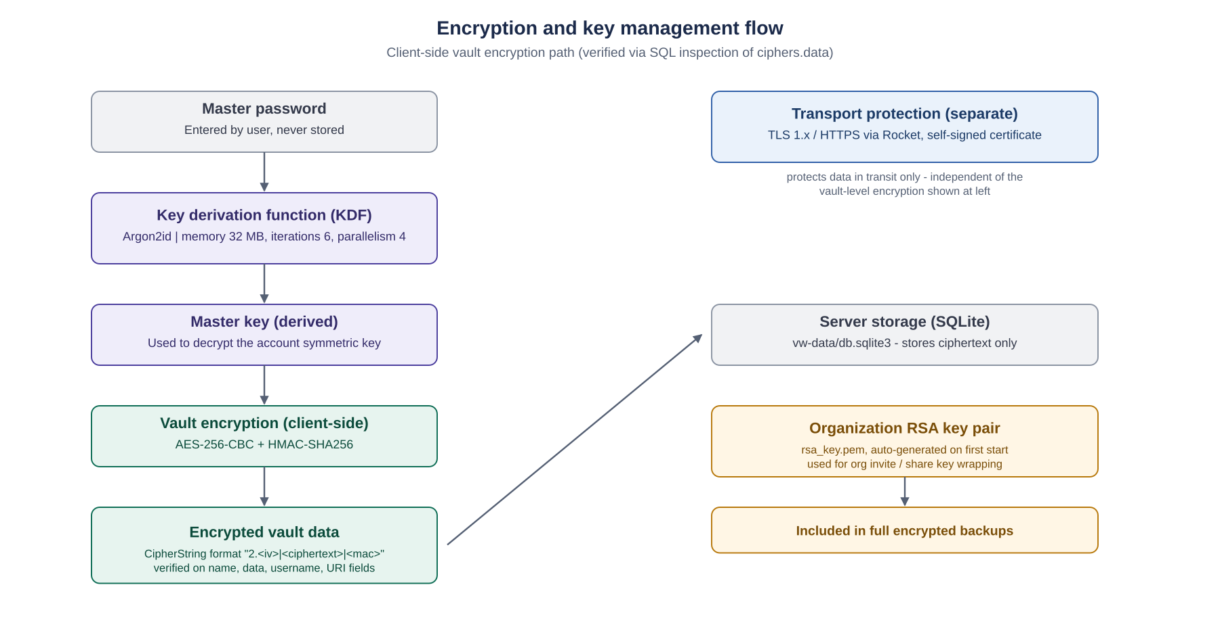
ENCRYPTION & KEY MANAGEMENT
Field-level AES-256, verified directly in the database
Verified
Argon2id — 32MB memory, 6 iterations, parallelism 4
CipherString "2." prefix confirmed on name, data, username, URI
AES-256-CBC + HMAC-SHA256 per Bitwarden spec
TLS protects transport only — a separate layer
Secure Password Manager Project — Vaultwarden Security Implementation
07
Notes:
Explain the envelope-encryption model briefly: master password -> Argon2id -> master key -> vault encryption. The critical evidence point is the CipherString '2.' prefix you found directly in the SQLite database - that's proof the encryption is actually happening, not just configured.

Slide 8
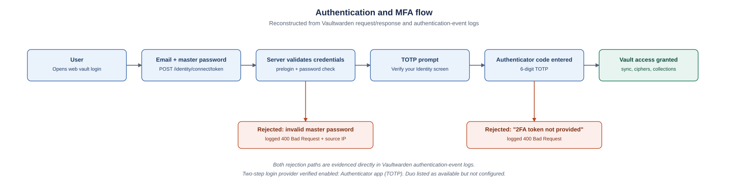
AUTHENTICATION & MFA
Two independently-enforced factors, both failure paths captured
Verified failure paths
Evidence correction
Invalid master password → logged with source IP, 400 Bad Request
"2FA token not provided" → the genuine MFA-failure evidence
One screenshot was misnamed "MFA_Failed_Login_Test" but actually showed a password error — corrected in the full report.
Secure Password Manager Project — Vaultwarden Security Implementation
08
Notes:
This is a good slide to slow down on. Explain that you found two distinct rejection paths in the server logs - one for a wrong password, one for a missing TOTP code - and that this is stronger evidence than a screenshot of the settings page. Be upfront about the evidence-naming correction; it shows rigor, not sloppiness.

Slide 9
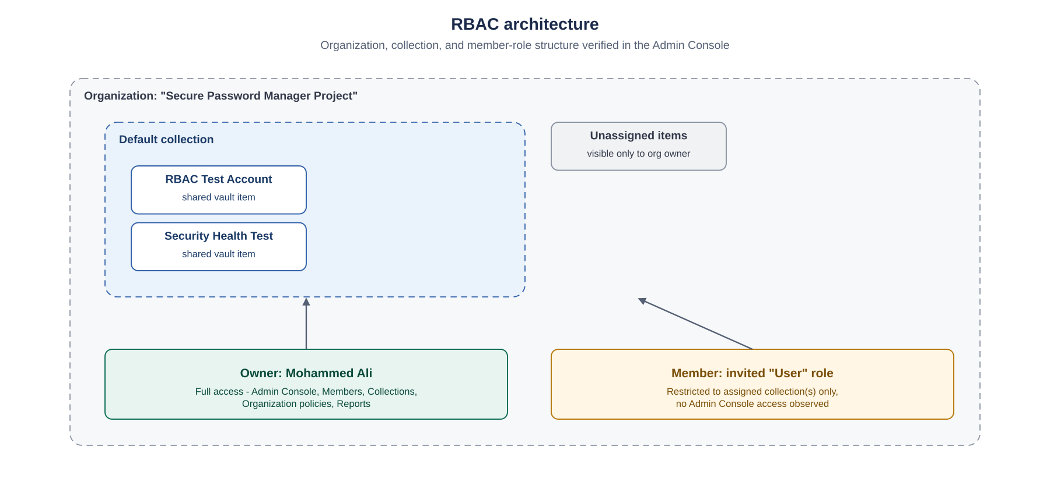
RBAC & ACCESS CONTROL
Restriction demonstrated with a second account, not just labeled
Demonstrated
Owner: full Admin Console, Members, Collections, Reports access
Invited "User" role: Default collection only
No Admin Console entry visible in the member’s navigation
Sharing confirmed via API log: PUT /api/ciphers/{id}/share → 200 OK
Secure Password Manager Project — Vaultwarden Security Implementation
09
Notes:
Explain that you didn't just create a member role and take Vaultwarden's word for it - you actually logged in as that second, restricted account and confirmed the Admin Console was missing from its navigation. That's the difference between configuring RBAC and verifying it.

Slide 10
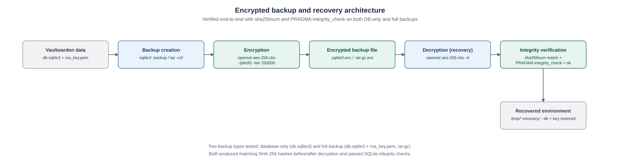
BACKUP & DISASTER RECOVERY
Encrypted, restored, and hash-verified — both backup types
AES-256-CBC
200,000
SHA-256
ok
Backup encryption
PBKDF2 iterations
Match confirmed
PRAGMA integrity_check
Secure Password Manager Project — Vaultwarden Security Implementation
10
Notes:
Walk through the four stat tiles: strong encryption, strong iteration count, and - most importantly - a byte-for-byte SHA-256 match after decryption plus a passing SQLite integrity check. This is what makes a backup trustworthy rather than just present.

Slide 11
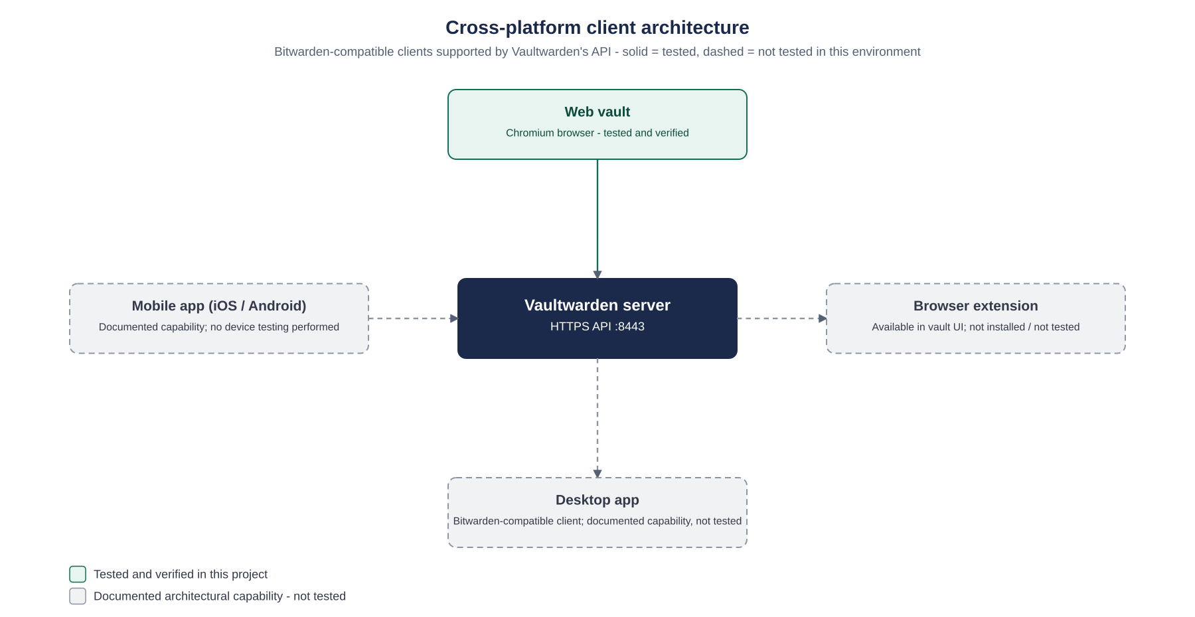
CROSS-PLATFORM ARCHITECTURE
Web vault tested; other clients are documented capabilities
Honest scope
Web vault: tested and verified
Browser extension: offered in UI, never installed
Desktop app: not connected to this instance
Mobile app: no device testing performed
Secure Password Manager Project — Vaultwarden Security Implementation
11
Notes:
Be direct here: only the web vault was tested. The other three clients are real Bitwarden-compatible capabilities, but you didn't install or test them, so they're marked honestly as untested rather than implied to work.

Slide 12
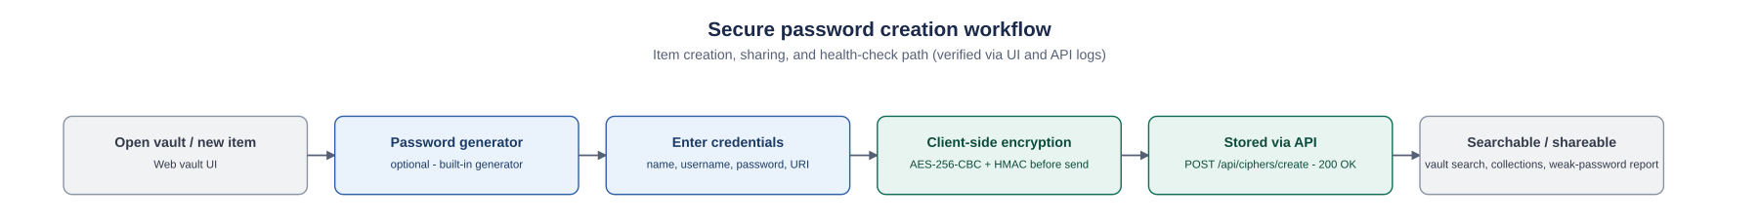
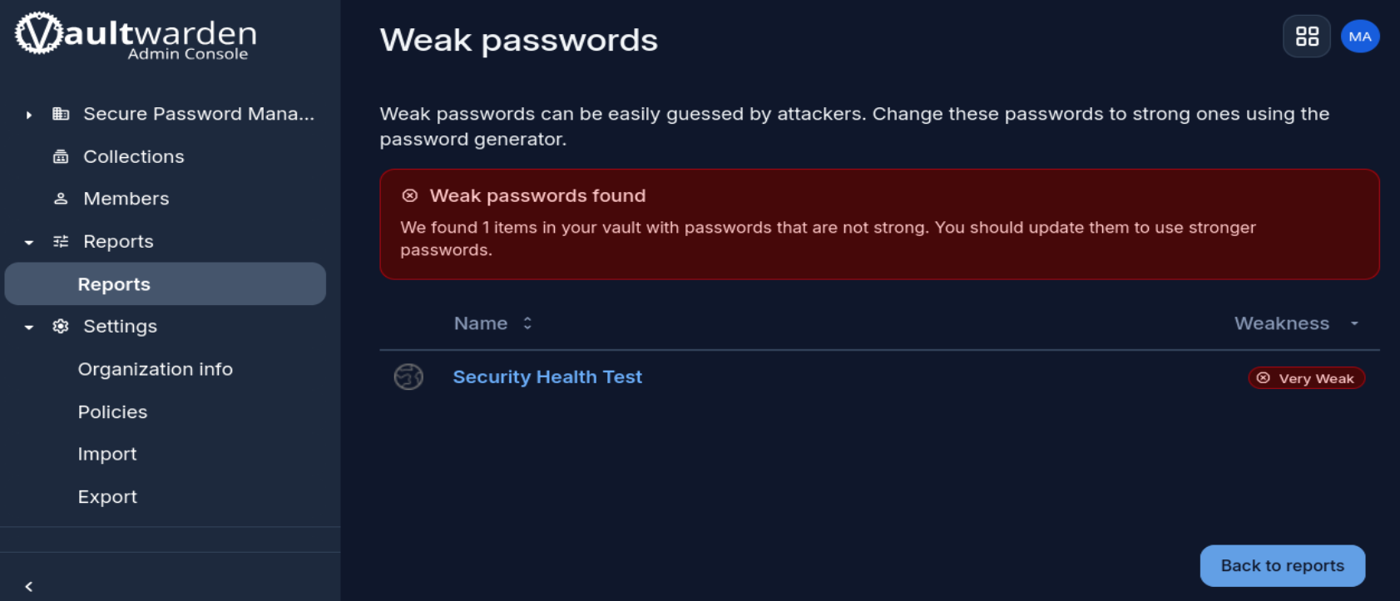
USABILITY & PASSWORD SECURITY
Search, sharing, and password-health checks all verified
Verified this stage
Vault search correctly filters to matching items
Organization weak-password report flags a "Very Weak" item
Item creation and sharing confirmed via API logs (200 OK)
Secure Password Manager Project — Vaultwarden Security Implementation
12
Notes:
Show the weak-password report as a concrete, working feature - the system correctly flagged a genuinely weak test password. Mention the sharing operation was confirmed via API logs even though you don't have a UI screenshot of the share dialog itself.

Slide 13
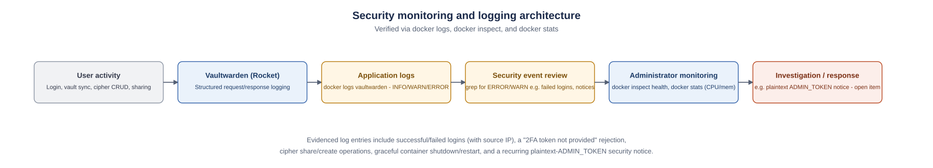
MONITORING & LOGGING
Structured logs surfaced both successes and open findings
Captured in logs
Open finding
Successful login with source IP
Failed login and missing-TOTP rejections
Cipher create/share operations
Graceful container shutdown & restart
Vaultwarden’s own NOTICE: plaintext ADMIN_TOKEN is insecure — recurs in later logs, not shown resolved
Secure Password Manager Project — Vaultwarden Security Implementation
13
Notes:
Point out the open finding here deliberately - Vaultwarden itself logged a notice that the admin token was stored in plain text, and that notice reappears in a later log capture, meaning it was never fixed. This is a good example of the report not hiding an uncomfortable finding.

Slide 14
SECURITY TESTING
Twenty direct tests — not a review of configuration screenshots
curl
openssl
sqlite3
docker
HTTPS headers & response codes
TLS certificate & encryption
Ciphertext & schema inspection
Logs, health checks, resource stats
Testing approach
Every claim in the report is tied to a specific command, its output, and an evidence file — not inferred from a settings page
Where evidence was ambiguous or contradictory (e.g. two different file-permission readings), both readings are reported rather than the more favorable one
Where no evidence exists (mobile, browser extension), the capability is labeled "documented, not tested" rather than assumed to work
Secure Password Manager Project — Vaultwarden Security Implementation
14
Notes:
Explain the testing philosophy: every one of the twenty tests ties back to a specific command and its output. Where evidence conflicted - like the two different file-permission readings - both readings were reported rather than picking the more flattering one.

Slide 15
TEST RESULTS
20 test cases across every control area
Representative passes
TC-01/02: HTTPS headers + TLS cert confirmed
TC-06: "2FA token not provided" — genuine MFA failure
TC-08: restricted member access demonstrated live
TC-12/13: backups decrypt with matching SHA-256 hashes
The two non-clean results
TC-14 (Inconclusive): rsa_key.pem permissions read as both 600 and 644 across two checks — final state unconfirmed
TC-20 (Not tested): browser-extension autofill — the extension was never installed
Secure Password Manager Project — Vaultwarden Security Implementation
15
Notes:
Walk through the donut chart: fifteen clean passes, three passes with a caveat worth noting, one inconclusive result, and one that was never tested. Spend a moment on the two non-clean results specifically, since those are the most interesting from a security standpoint.

Slide 16
LIMITATIONS
Constraints by design, and findings left open by the evidence
Laboratory constraints (by design)
Open findings (not shown resolved)
Self-signed certificate; loopback/local-network only
No mobile client or browser-extension testing
No SSO, Duo, emergency-access, or Send testing
No load, performance, or multi-user testing
Vaultwarden is an unofficial Bitwarden-compatible server
Plaintext ADMIN_TOKEN — flagged by Vaultwarden itself, notice recurs later
rsa_key.pem permissions inconsistent (600 vs 644)
SIGNUPS_ALLOWED left enabled in the final configuration
No rate-limiting evidenced for repeated failed logins
Secure Password Manager Project — Vaultwarden Security Implementation
16
Notes:
Distinguish clearly between the two boxes: laboratory constraints are things you chose not to test because they were out of scope, while open findings are things the evidence itself surfaced as unresolved. Neither is a failure - both are honest accounting.

Slide 17
SECURITY RECOMMENDATIONS
Moving from lab proof-of-concept to production
1
Convert ADMIN_TOKEN to an Argon2 hash
2
Issue a CA-trusted certificate
Directly instructed by Vaultwarden’s own log notice
Before any use beyond the local lab
3
Add rate-limiting on failed logins
4
Fix rsa_key.pem to 600 consistently
No lockout mechanism was evidenced
Resolve the observed permission inconsistency
5
Disable open sign-ups
6
Establish backup rotation + off-host copy
Set SIGNUPS_ALLOWED=false once accounts exist
Backups currently live alongside the deployment
Secure Password Manager Project — Vaultwarden Security Implementation
17
Notes:
These six recommendations map directly to the findings on the previous two slides. If asked what you'd do next with more time, these are your answer - lead with the admin token and the certificate, since those carry the highest risk.

Slide 18
KEY OUTCOMES
What this project actually demonstrated
20
15
2
0
Direct security tests performed
Fully verified, clean-pass controls
Open findings honestly disclosed
Fabricated or assumed results
Bottom line
Core controls — encryption, MFA, RBAC, encrypted/restore-tested backups — were configured and independently verified, not just claimed
Every gap that remains (admin-token hashing, key permissions, rate-limiting) is identified precisely enough to close before production use
The project is best read as a working laboratory proof of concept, not a production-ready deployment
Secure Password Manager Project — Vaultwarden Security Implementation
18
Notes:
Use this as your summary slide if time is short: twenty tests, fifteen clean passes, two disclosed open findings, and zero fabricated results. That last number is worth emphasising - it's the core academic-integrity claim of the whole project.

Slide 19
CONCLUSION
Configuration and verification are two different activities.
A security claim is only as strong as the test that was actually run to support it. This project treated that as the standard throughout: every control implemented was independently tested, every limitation encountered was disclosed rather than smoothed over, and every claim in the final report traces back to a specific command, its output, and an evidence file.
VW
Strong key derivation. Genuine field-level encryption. Enforced MFA. Working access control. Recoverable encrypted backups. And an honest account of what still needs to change before this leaves the lab.
Secure Password Manager Project — Vaultwarden Security Implementation
19
Notes:
Deliver the closing statement slowly: configuration and verification are different activities, and a security claim is only as strong as the test behind it. This is the thesis of the whole project - let it land before moving to Q&A.

Slide 20
VW
Questions?
Implementing Security into a Secure Password Manager Application — Mohammed Ali
Full evidence, diagrams, and test records available in the accompanying written report.
Notes:
Open the floor. If asked for evidence on any specific claim, you can point to the exact screenshot or log line in the full written report, since every figure there is numbered and cross-referenced.

